Slide 1
Determining the Density of HD 189733b
Kolya Larson, Matt Lastovka, Cassie Moats, Sam Eckart, William Wu

Slide 2
Motivation
Determine a single exoplanet density by combining the results of different detection methods
Transit (recovers radius) & Radial Velocity (recovers mass) methods
Easily extends to any exoplanet with known results in these methods
Infer the composition of an exoplanet using its density
Gives us clues about the formation history of the exoplanet which ties in with its potential habitability
More accurately define what “earth-like” exoplanets are

Slide 3



Methodology (Mass)
Begin with RV Amplitude
Solve for exoplanet mass
Inclination is unknown – we assume sin(i) = 1 to find the minimum mass
Determine semi-major axis
To simplify the process, we use EXOFAST fitting
Mp = (1.18 ± 0.04) MJ

Slide 4
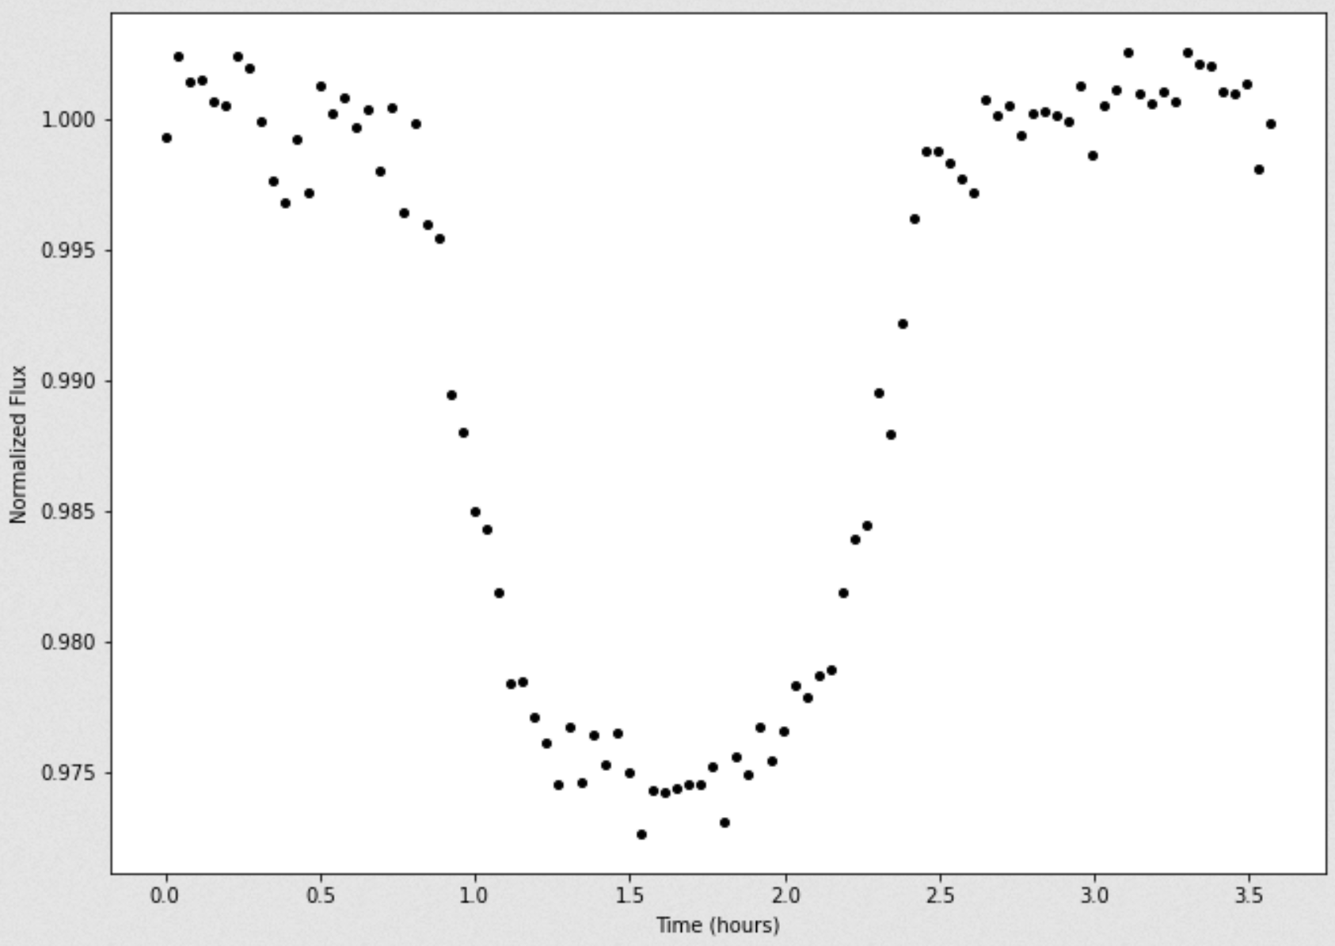


Methodology (Radius)
Begin with depth of transit equation
Solve for radius of the exoplanet
f is the flux difference between the inside and outside of a transit
Rp = (1.20 ± 0.02) RJ

Slide 5

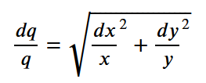

Methodology (Density & Error Propagation)
Assume a spherical exoplanet, then
Density is then given by
ρ = (0.847 ± 0.06) g/cm³
Relative errors add in quadrature following this rule

Slide 6
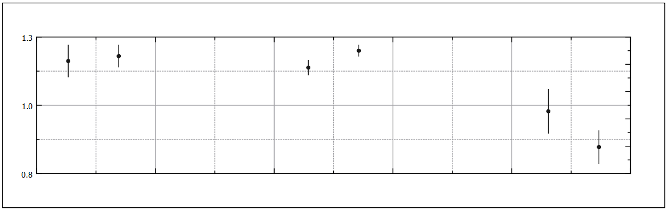
Results (Mass, Radius, Density)
 | Mass (MJ) | Radius (RJ) | Density (g/cm³)
Expected | 1.162 ± 0.058 | 1.138 ± 0.027 | 0.978 ± 0.08
Measured | 1.18 ± 0.04 | 1.20 ± 0.02 | 0.847 ± 0.06
Mass
Radius
Density

Slide 7
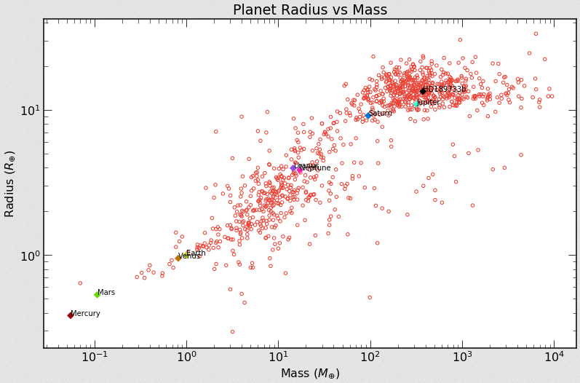
Results (NEA Data Comparison)

Slide 8
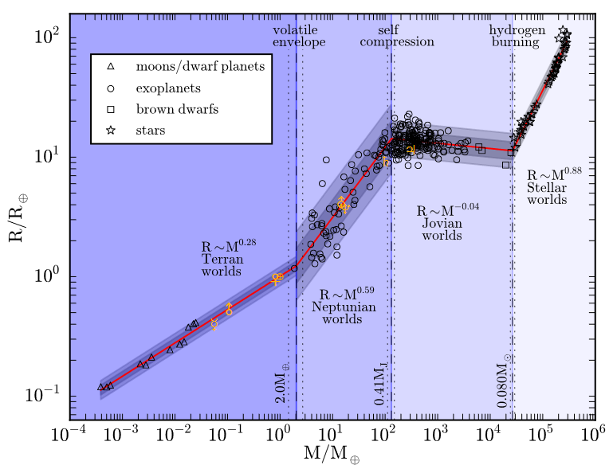
Results (Chen & Kipping M-R Relation)

Slide 9
Conclusions
We can use the results of detection methods to determine new information about an exoplanet
The combination of of detection methods reveals more information than each do individually
HD 189733b is a Jovian (gaseous) planet as evident from the M-R relationship
Less dense than Jupiter by around 0.5 g/cm³
Less dense than Earth by around 4.7 g/cm³
Obviously uninhabitable

